Slide 1

Logged-in homepage V1
Authenticate experience team // June 2020

Slide 2
Findings review

Slide 3
Logged-in homepage discovery findings
1
People want a task-based logged-in homepage tailored to them.
4
Records and documents are a focus for Veterans.
2
Health care and disability benefits are king.
5
The logged-in homepage needs to scale to support every phase of the Veteran lifecycle.
3
Veterans care about anything they have in flight, whether that is education or other benefits.

Slide 4
Logged-in homepage discovery findings
6
The existing "blue sky" prototype gets a lot of things right.
8
The homepage needs to be supported by a cohesive logged-in navigation.
7
Veterans expect a mix of links and widgets to complete tasks from their homepage.
9
Veterans want new information to be clear when they log in, and expect to receive new info through multiple channels.

Slide 5
What should go into V1?

Slide 6
Goals
Essentially, veterans want a task-based logged-in homepage that reflects their experience at the VA.

Slide 7
Goals
From a stakeholder perspective, the big concern is this: how can we make incremental progress? How can we structure this project so we aren’t held back by perfection?

Slide 8
Goals
So, V1 of the logged-in homepage should meet both of these requirements.

Slide 9
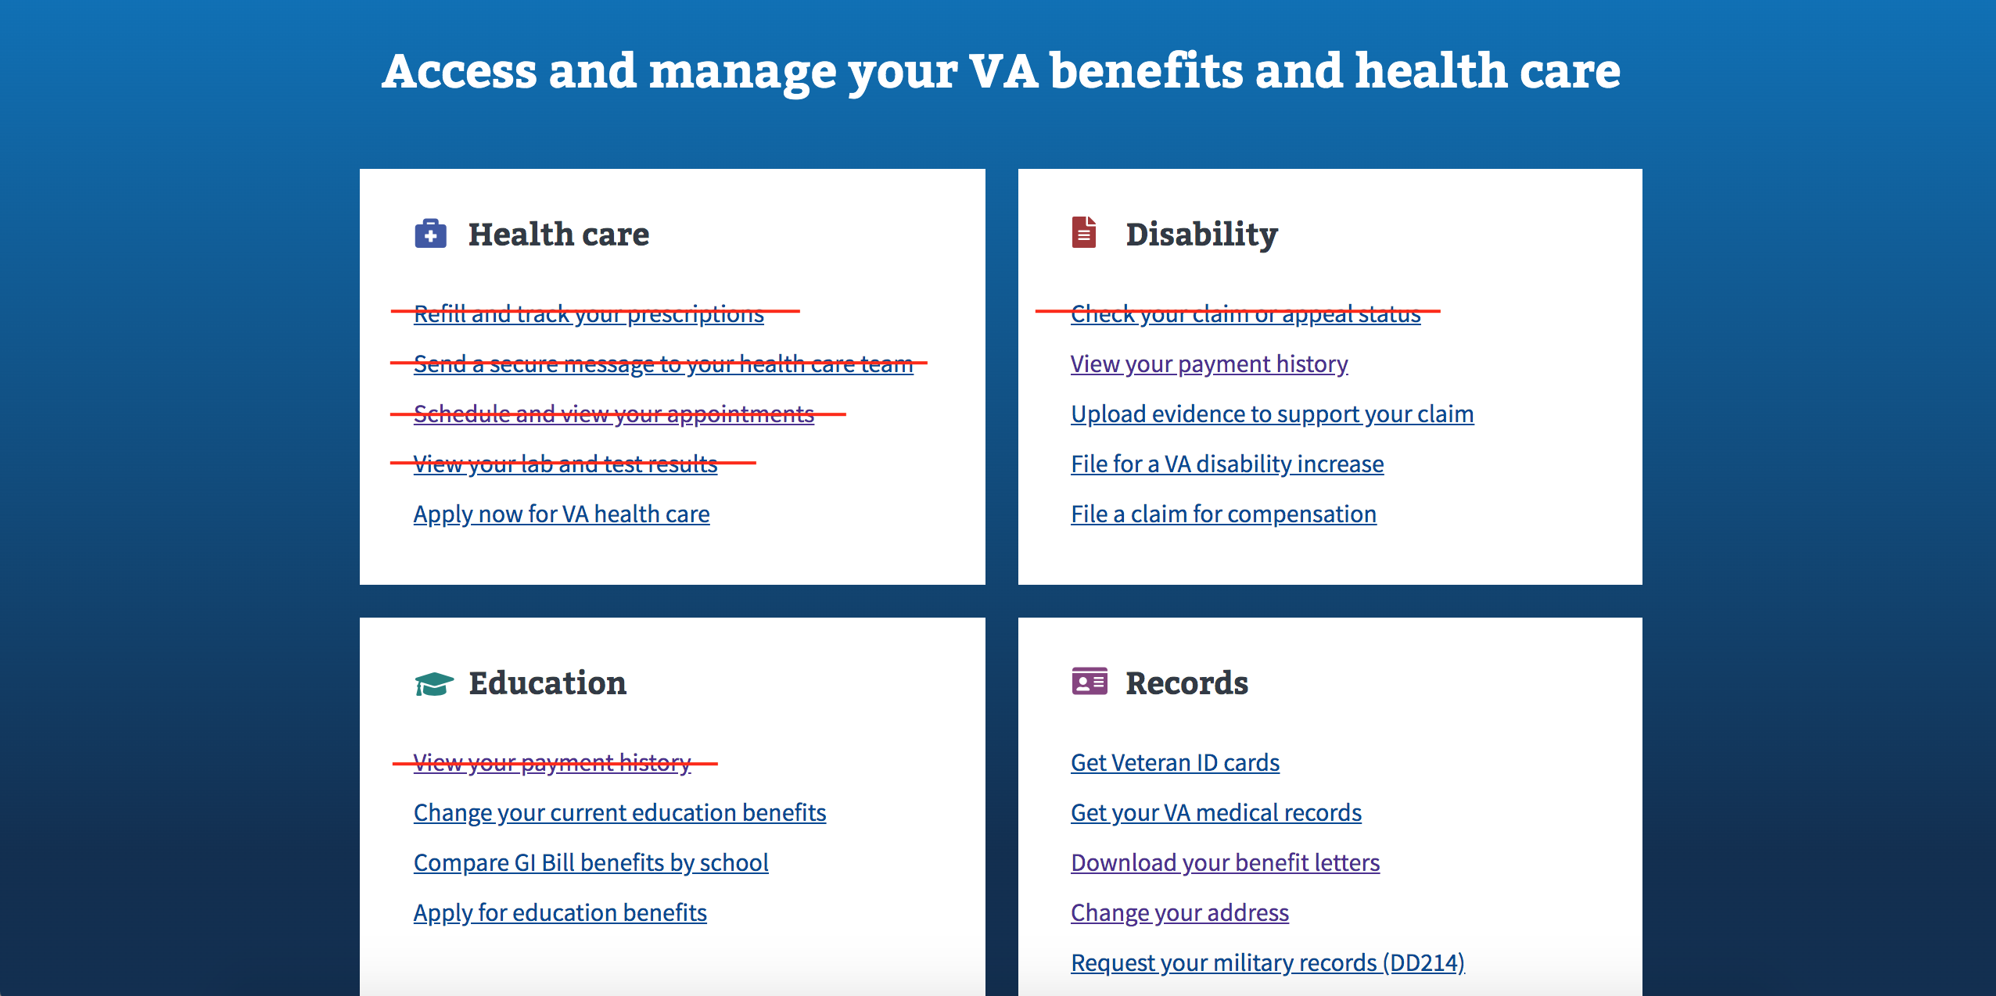
The smallest change

Slide 10
The Smallest change
Task-based
✅
Incremental change
✅
❌
Reflects personal experience at the VA

Slide 11
A better way
A better V1 needs to reflect the personal experience of veterans at the VA.

Slide 12
What veterans want: healthcare
Secure messaging
Appointments
Summary of what occurred in an appointment
Ordering prescriptions and medical supplies
Medical records (downloading and sharing with community care locations)
Lab and test results (current and over time)
Beneficiary travel
Their VA Medical Center (where they primarily receive care)
Community Care locations

Slide 13
What veterans want: Disability
Rated disabilities
Claim status
File a secondary claim or to increase rating
Upload requested documents
Payment history
Vocational Rehabilitation information (how-to, and what to fill out)
Housing grant balance
Additional benefits available to them and their dependents

Slide 14
What veterans want: Education
GI Bill benefits balance
Details on how benefit has been paid out

Slide 15
What veterans want: Records & Documents
Eligibility packet created by the VA
Award letters
Military history
DD214
Uploading documents, and viewing previous documents they uploaded

Slide 16
A better way
Good news! Most of that is information we either show on My VA or tools we link to from the existing homepage.

Slide 17
A better way
The challenge now is to bring the personalized information we have on My VA to the logged-in homepage so it can work in tandem with the links we already have into popular tools.

Slide 18
Version 1 proposal
In scope:
Move the following My VA tools over to the homepage:
  Your applications
  Your claims
  Health enrollment status (eg. enrolled; application pending, etc)
  Prescriptions
  Secure messages
  Schedule appointments

Slide 19
Version 1 proposal
In scope:
A plan for how to incorporate top 20 tasks links, including directing veterans to the records and documents.
A visual redesign of the My VA elements moving over to the logged-in homepage.
A very basic first-time user experience that will account for users who have no benefits and no applications in flight.
Retiring My VA.
(Nice to have) Elevating overall disability ratings, GI bill balances, and upcoming appointments.

Slide 20
Version 1 proposal
Out of scope:
Doing anything with the Find VA benefits content that currently exists on My VA.
Incorporating any new data or integrations that do not already exist on VA.gov.
Navigation work.
Notification center work.

Slide 21
Version 1 proposal
Task-based
✅
Incremental change
✅
✅
Reflects personal experience at the VA

Slide 22
FUTURE PHASES
Given the importance of the logged-in homepage to both veterans and the teams building on VA.gov, we have already started considering what future phases might look like.

Slide 23
Phase 2: Improvements
Phase 2 will allow us to make updates based on ideas/needs generated during phase 1 or analytics we observe:
Disability rating, GI bill balance info, upcoming appointments if not included in phase 1.
Considering whether some tasks can be completed right from the homepage, and implementing functionality to allow this.
Showing new data, or data in a different way (eg. could we show where a prescription is en route?).
Prioritized additional features (eg. most recent payments, housing grant balance, etc).

Slide 24
Phase 3: A better first-time user experience and recommendations
While we will need to consider the first time experience in phase 1, there will likely be room for growth and improvement in how we are recommending next steps to all veterans. Phase 3, which might include:
Figuring out how to update the existing Find VA benefits flow.
A more fully-developed first-time user experience.
Additional benefit suggestions or recommendations based on personal circumstances (Eg. elevating voc rehab if we see you have a disability rating).

Slide 25
FUTURE PHASES
Truthfully, this effort is huge and we could (should?) have a dedicated team work on this product forever.

Slide 26
What about notifications and navigation?

Slide 27
Logged-in navigation
Needs to happen in addition to homepage work.
If resources allowed, this could happen at the same time as any phase of logged-in homepage development.
Will be iterative and happen incrementally over time
Will need to closely involve PW and IA teams.

Slide 28
Notification center
Notification center still needs to happen because logged-in homepage can not accommodate all notification-like information over time.
Can also happen at the same time as homepage development given available resources.
Should not lose sight of email and text notifications being the most important thing.

Slide 29
Questions and Discussion

Slide 30
Thanks!

